Slide 1

JavaScript fundamentals
12.08.2024

Slide 2




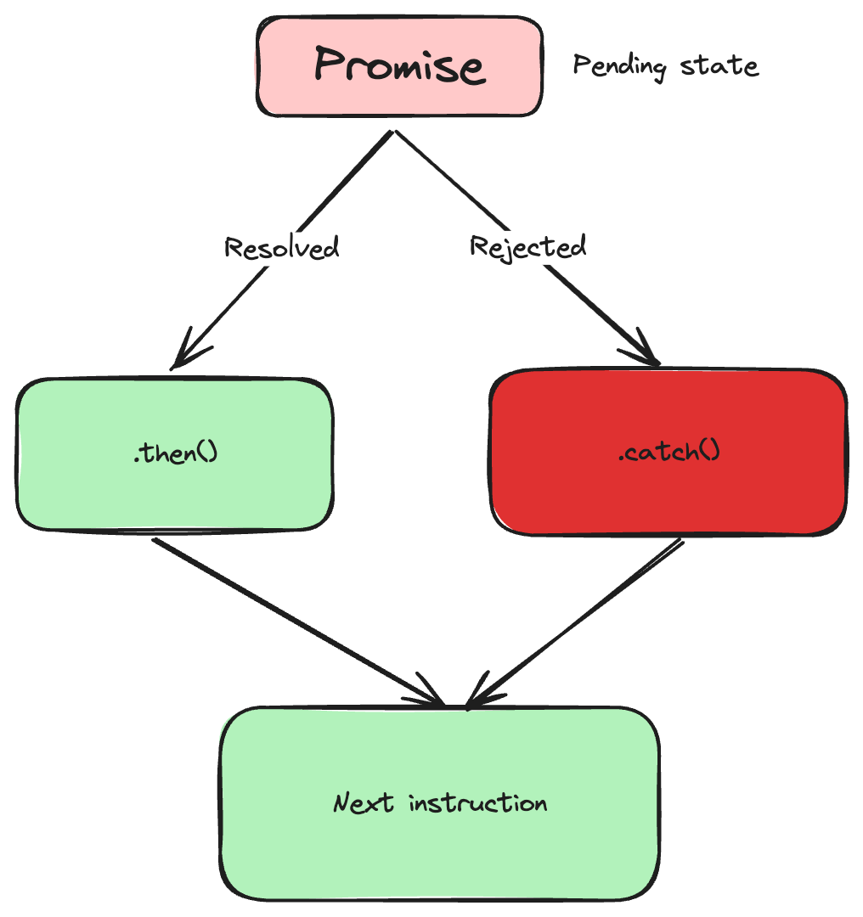
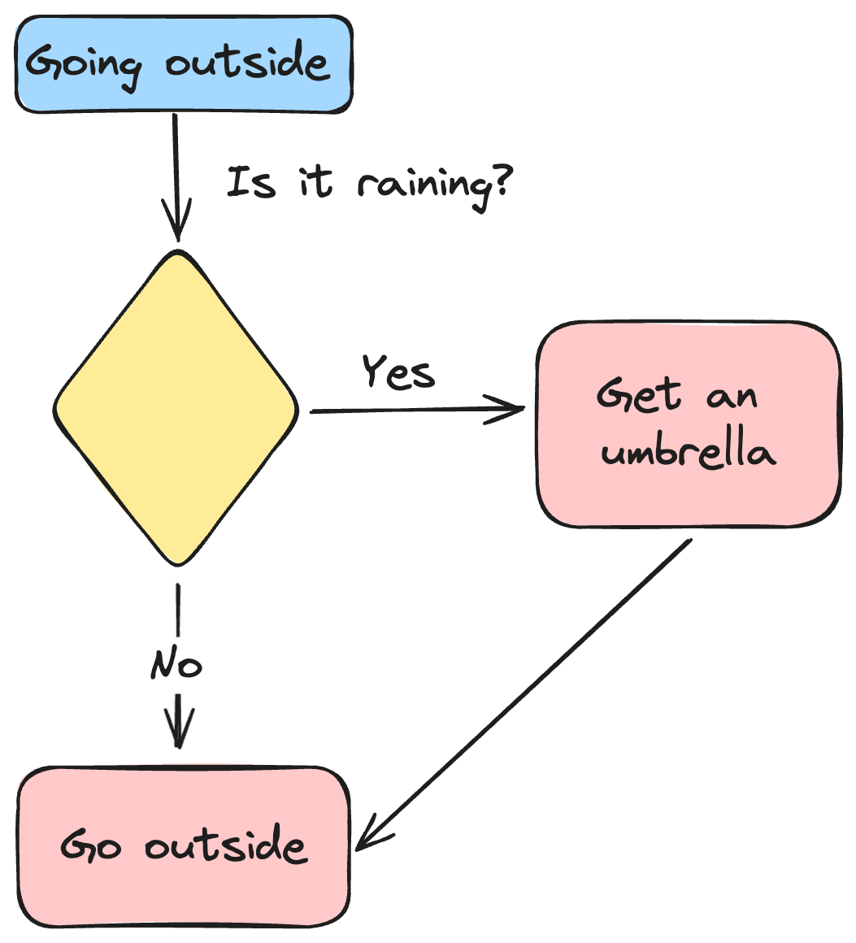
Plan
Day 1
Day 2
Day 3
Day 4
Local environment setup
Variables and data types
Operators
Controll structures
Functions
The infamous ‘this‘ keyword
Error handling
Asynchronous programming
Callbacks
Promises
Fetch api
Recap previous topics
Introduction to npm
Node.js event loop
Typescript
Exercises
Wrapping up
Resources and next steps

Slide 3

Day 1
Environment setup
Variables and datatypes
Operators
Control structures
Exercises
Free practice

Slide 4
1.0
Environment setup

Slide 5
Environment setup
Go to https://github.com/bniculea/javascript-fundamentals
Follow the steps from here
Run the “hello world” example

Slide 6
1.1
Variables and datatypes

Slide 7
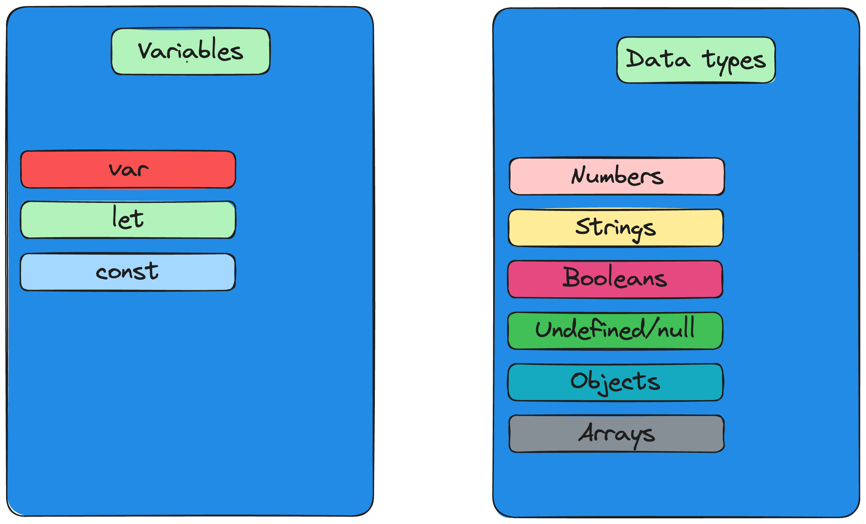
Variables and datatypes

Slide 8
1.2
Operators

Slide 9
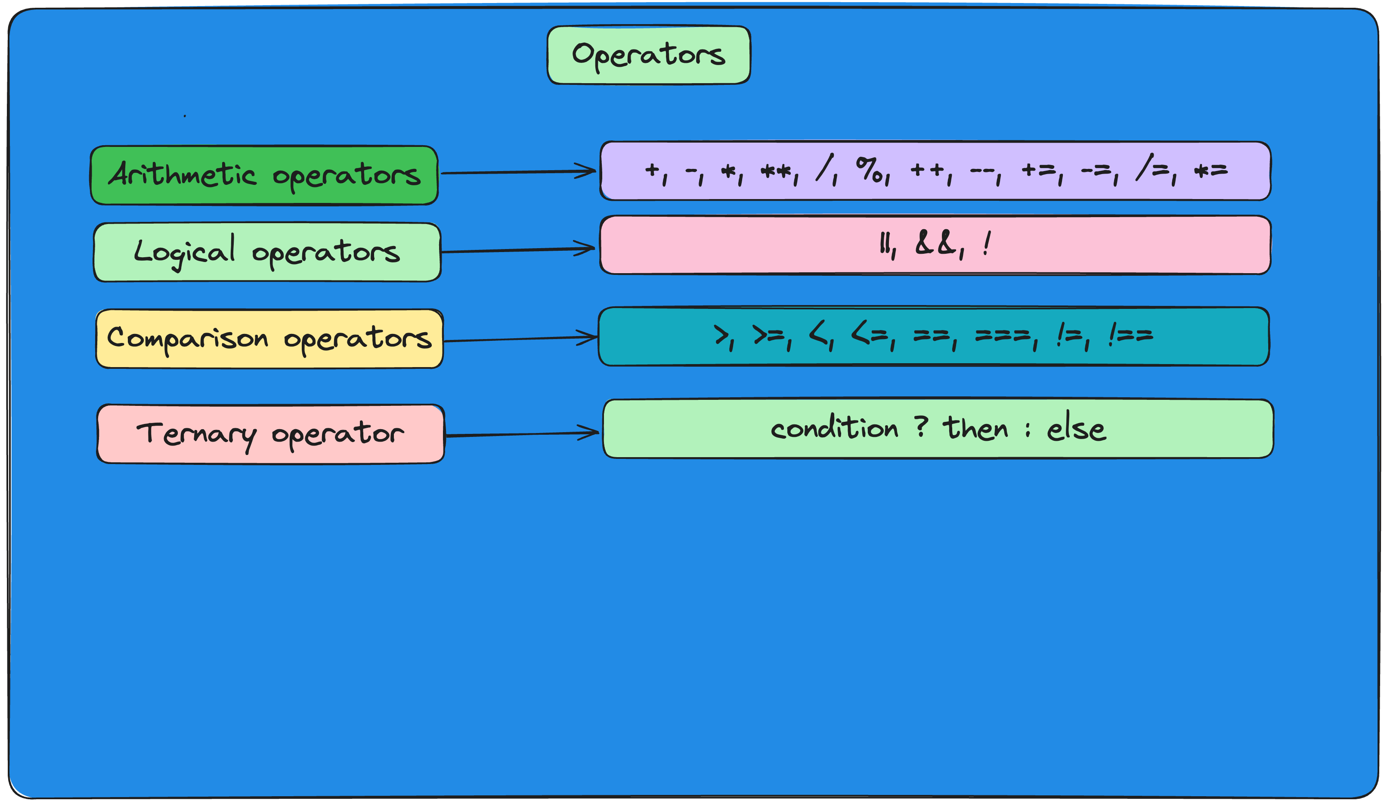
Operators

Slide 10
1.3
Control structures

Slide 11
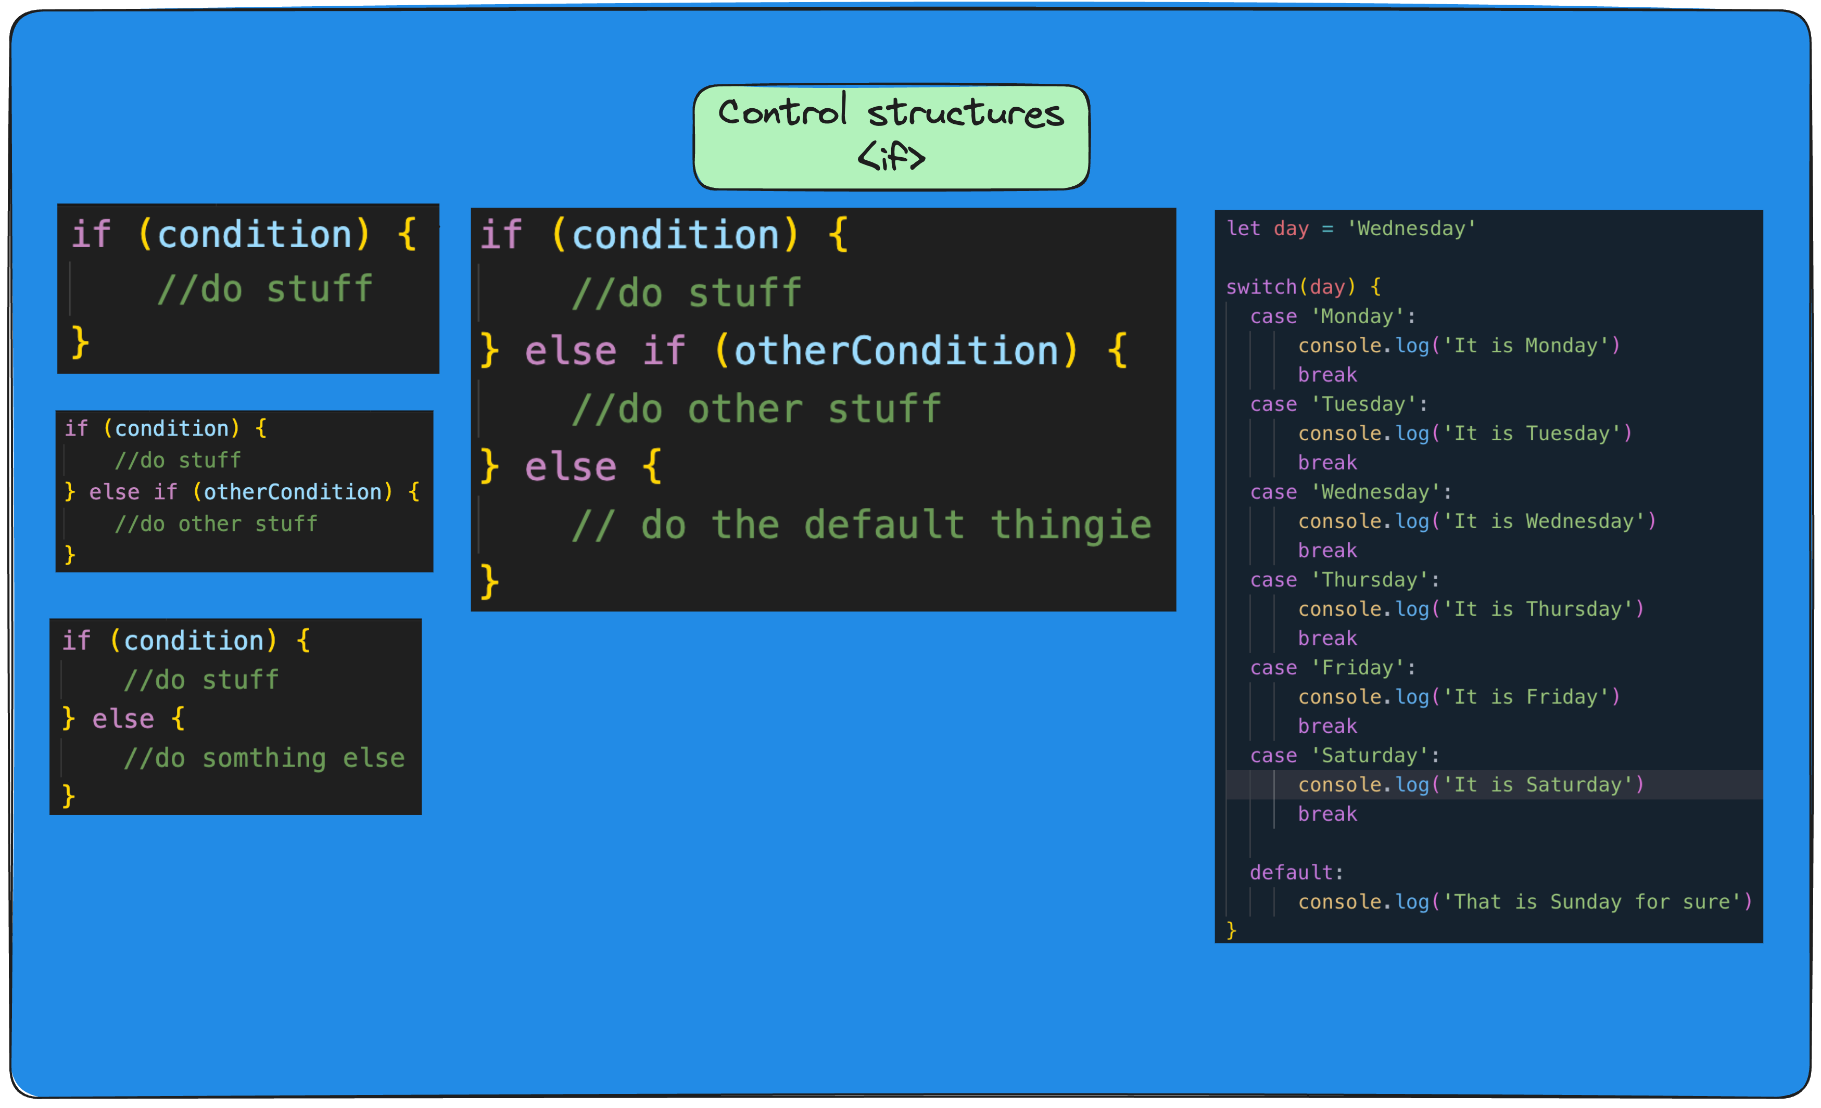
Control structures

Slide 12
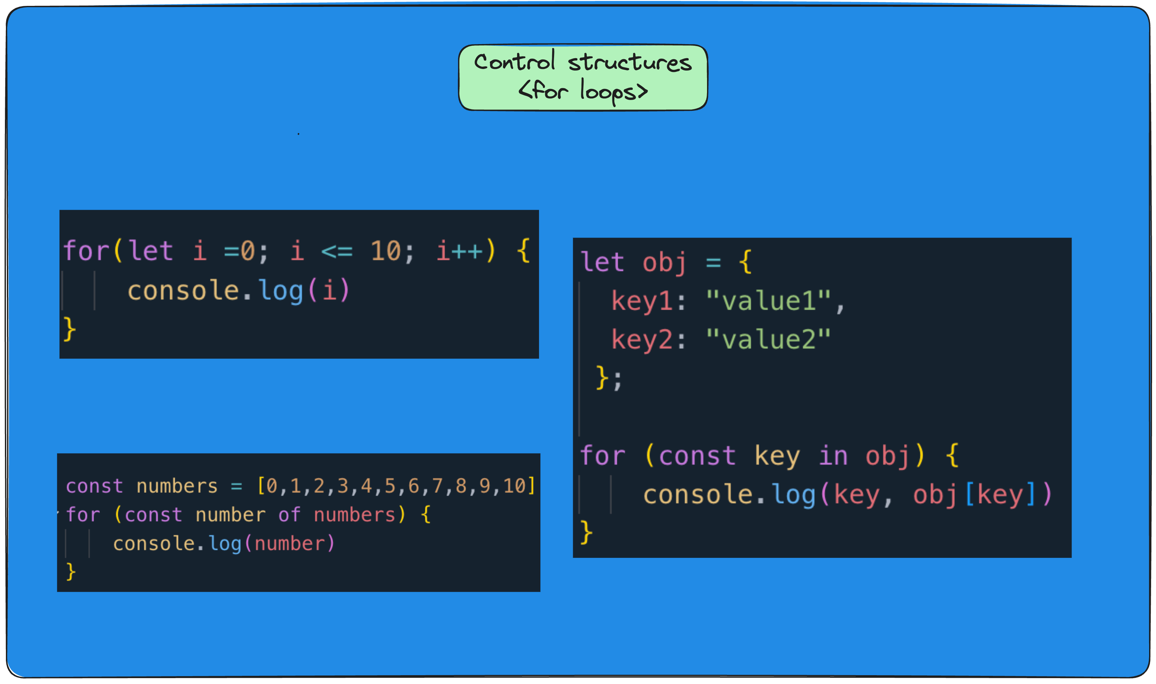
Control structures cont’d

Slide 13
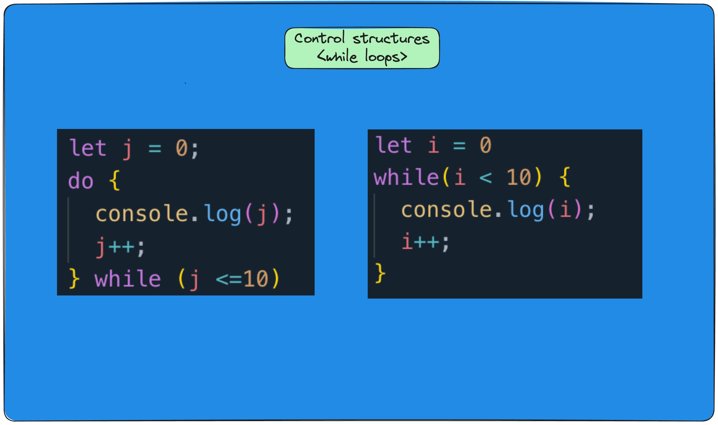
Control structures cont’d ||

Slide 14

Day 2
Introduction to functions
The „this“ keyword
Error handling
Asynchronous programming
Fetch API
Exercises
Free practice

Slide 15
2.1
Introduction to functions

Slide 16
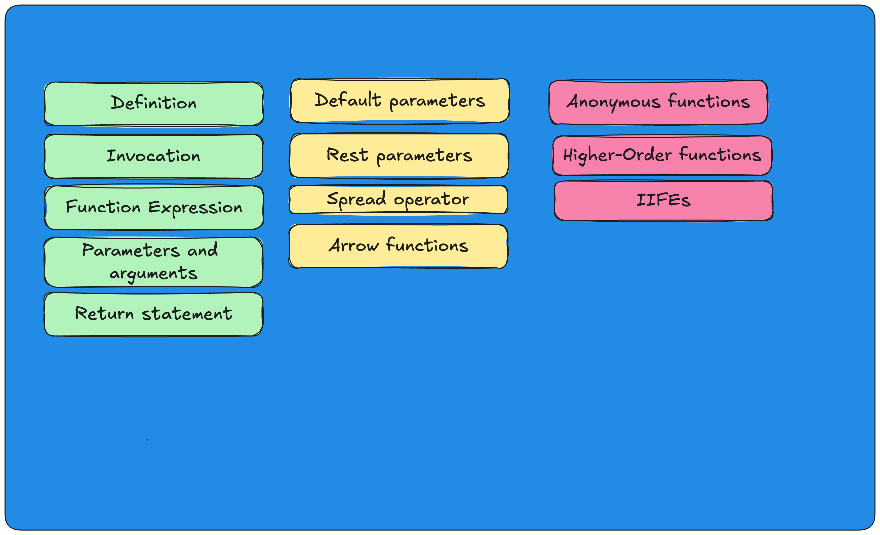
Functions

Slide 17
2.2
“this“ keyword

Slide 18
The “this” keyword
https://developer.mozilla.org/en-US/docs/Web/JavaScript/Reference/Operators/this

Slide 19
2.3
Error handling

Slide 20
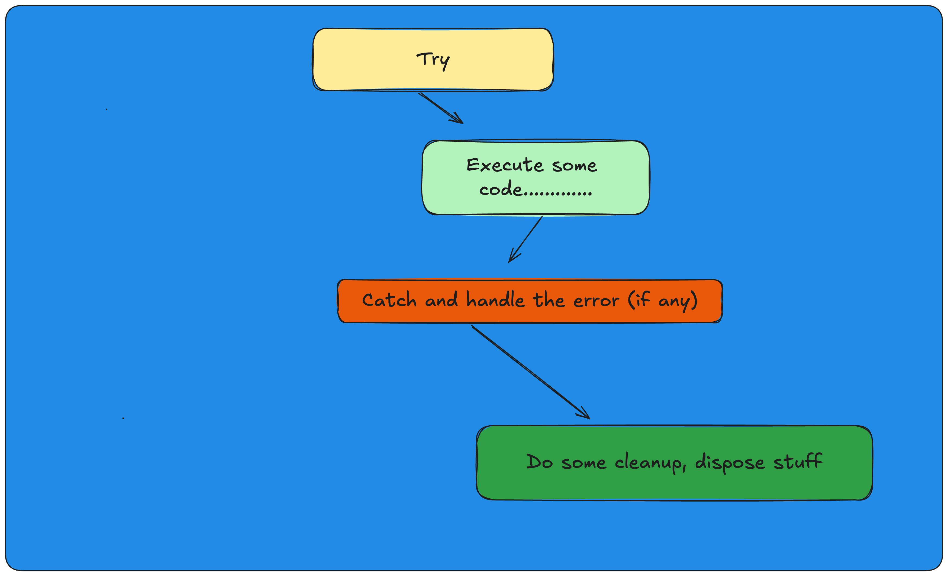
Error handling

Slide 21
2.4
Asynchronous programming

Slide 22
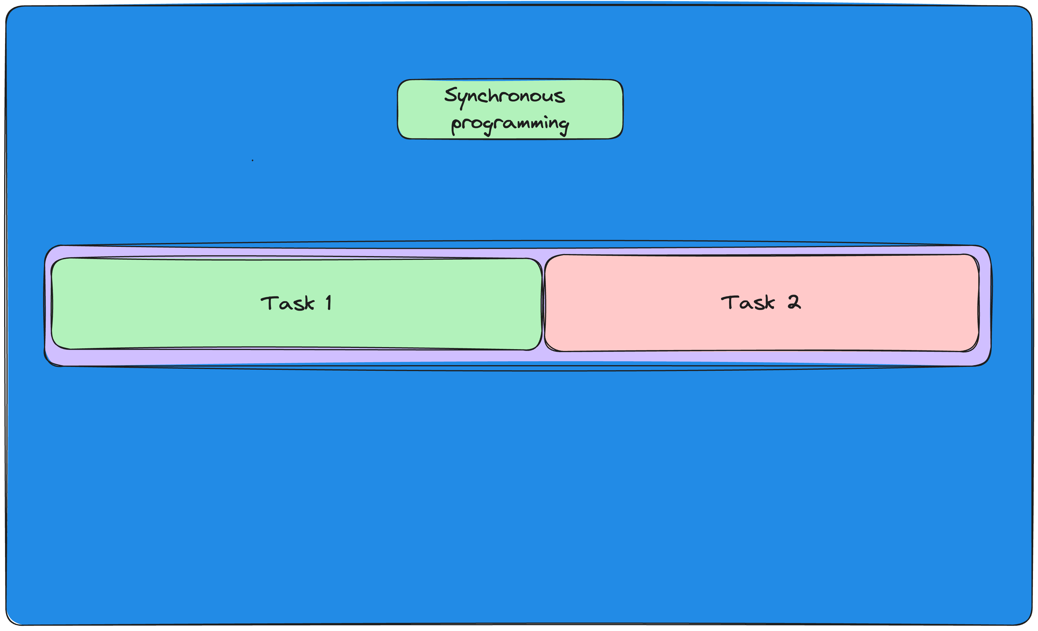
Synchronous programming

Slide 23
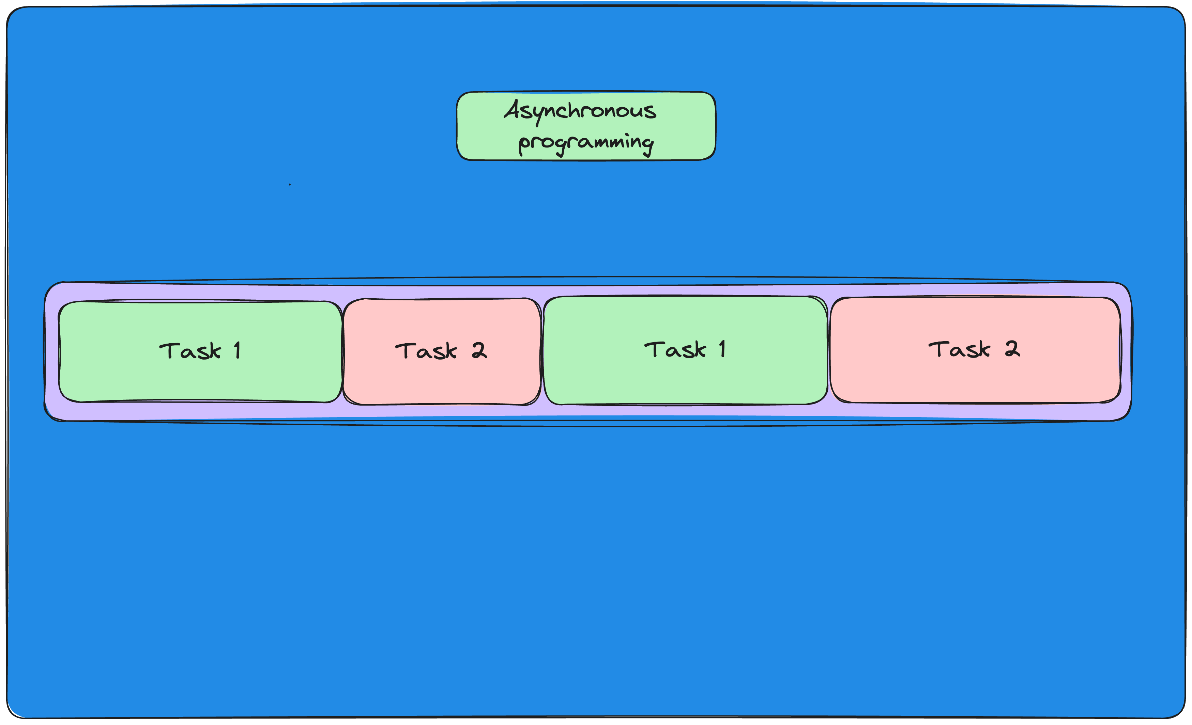
Asynchronous programming

Slide 24
Asynchronous programming

Slide 25
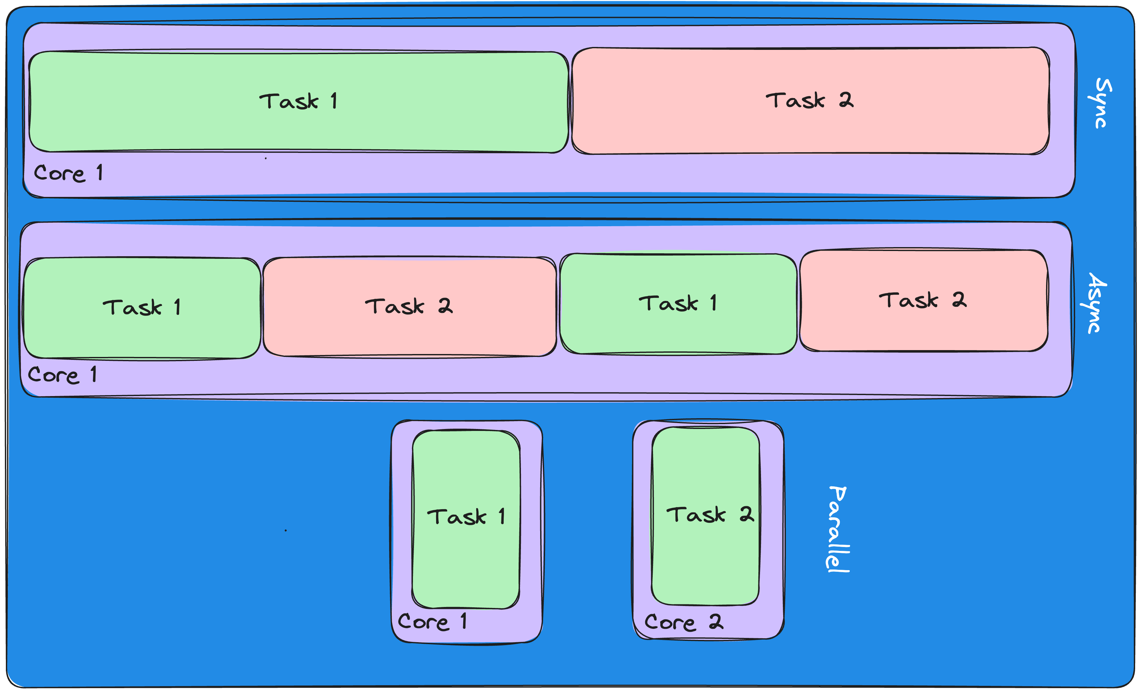
Sync vs Async vs Parallel

Slide 26
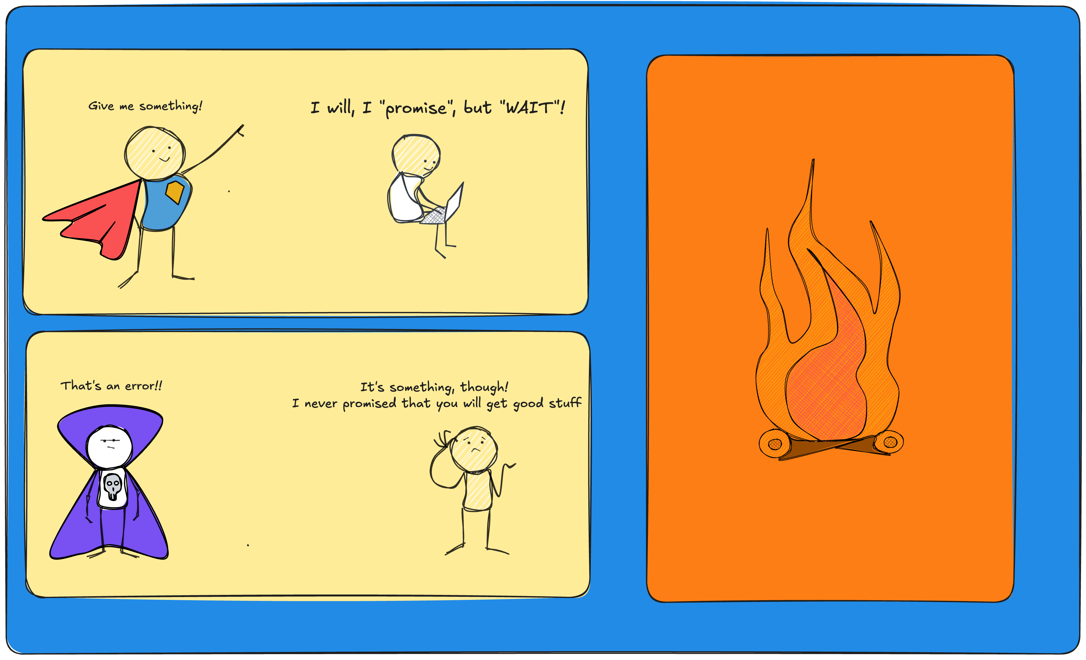
Promises

Slide 27
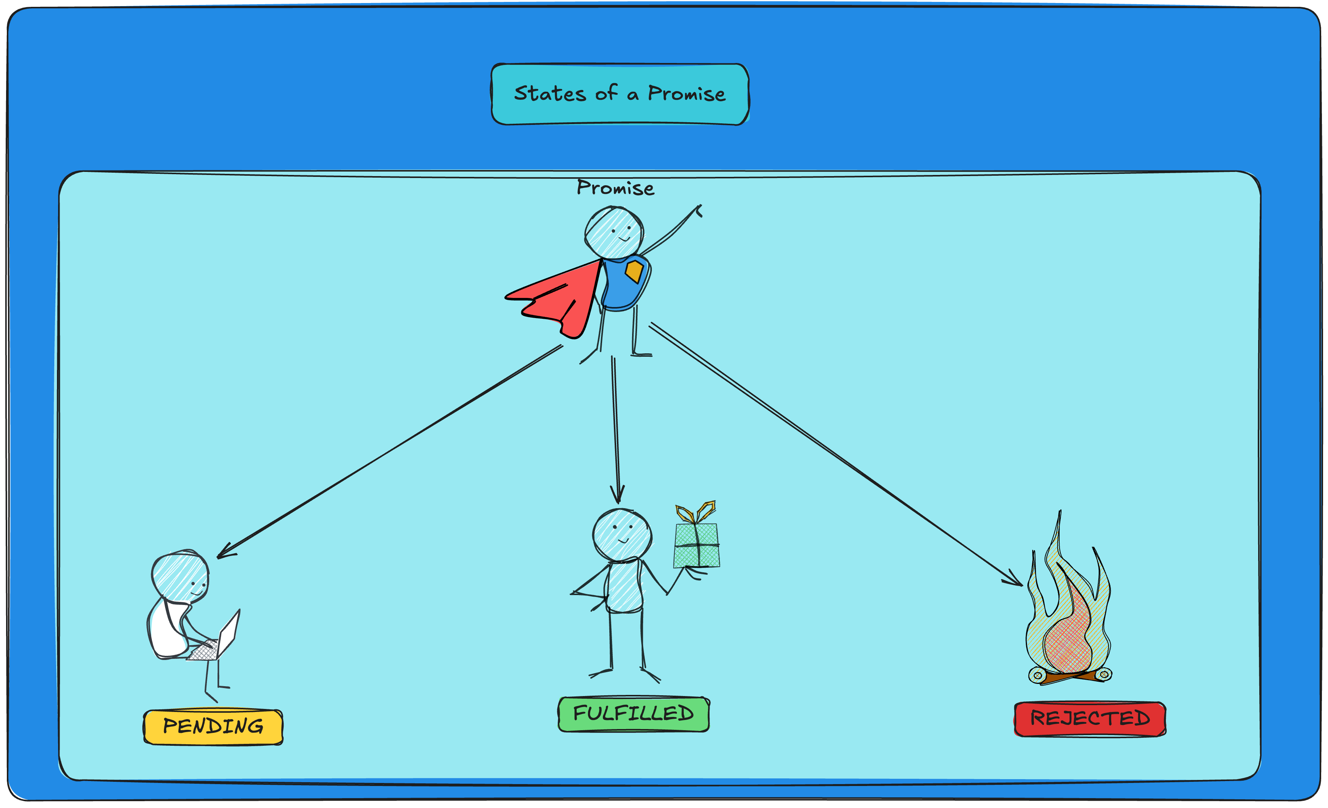
Promises

Slide 28
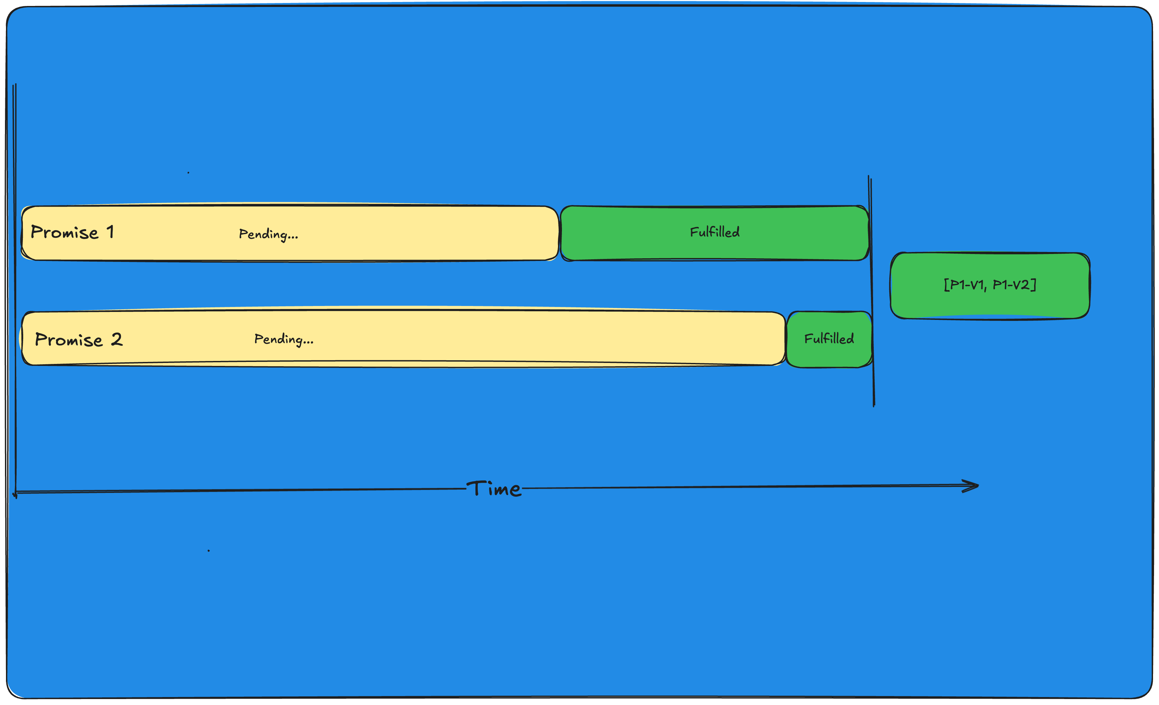
Promise.all()

Slide 29
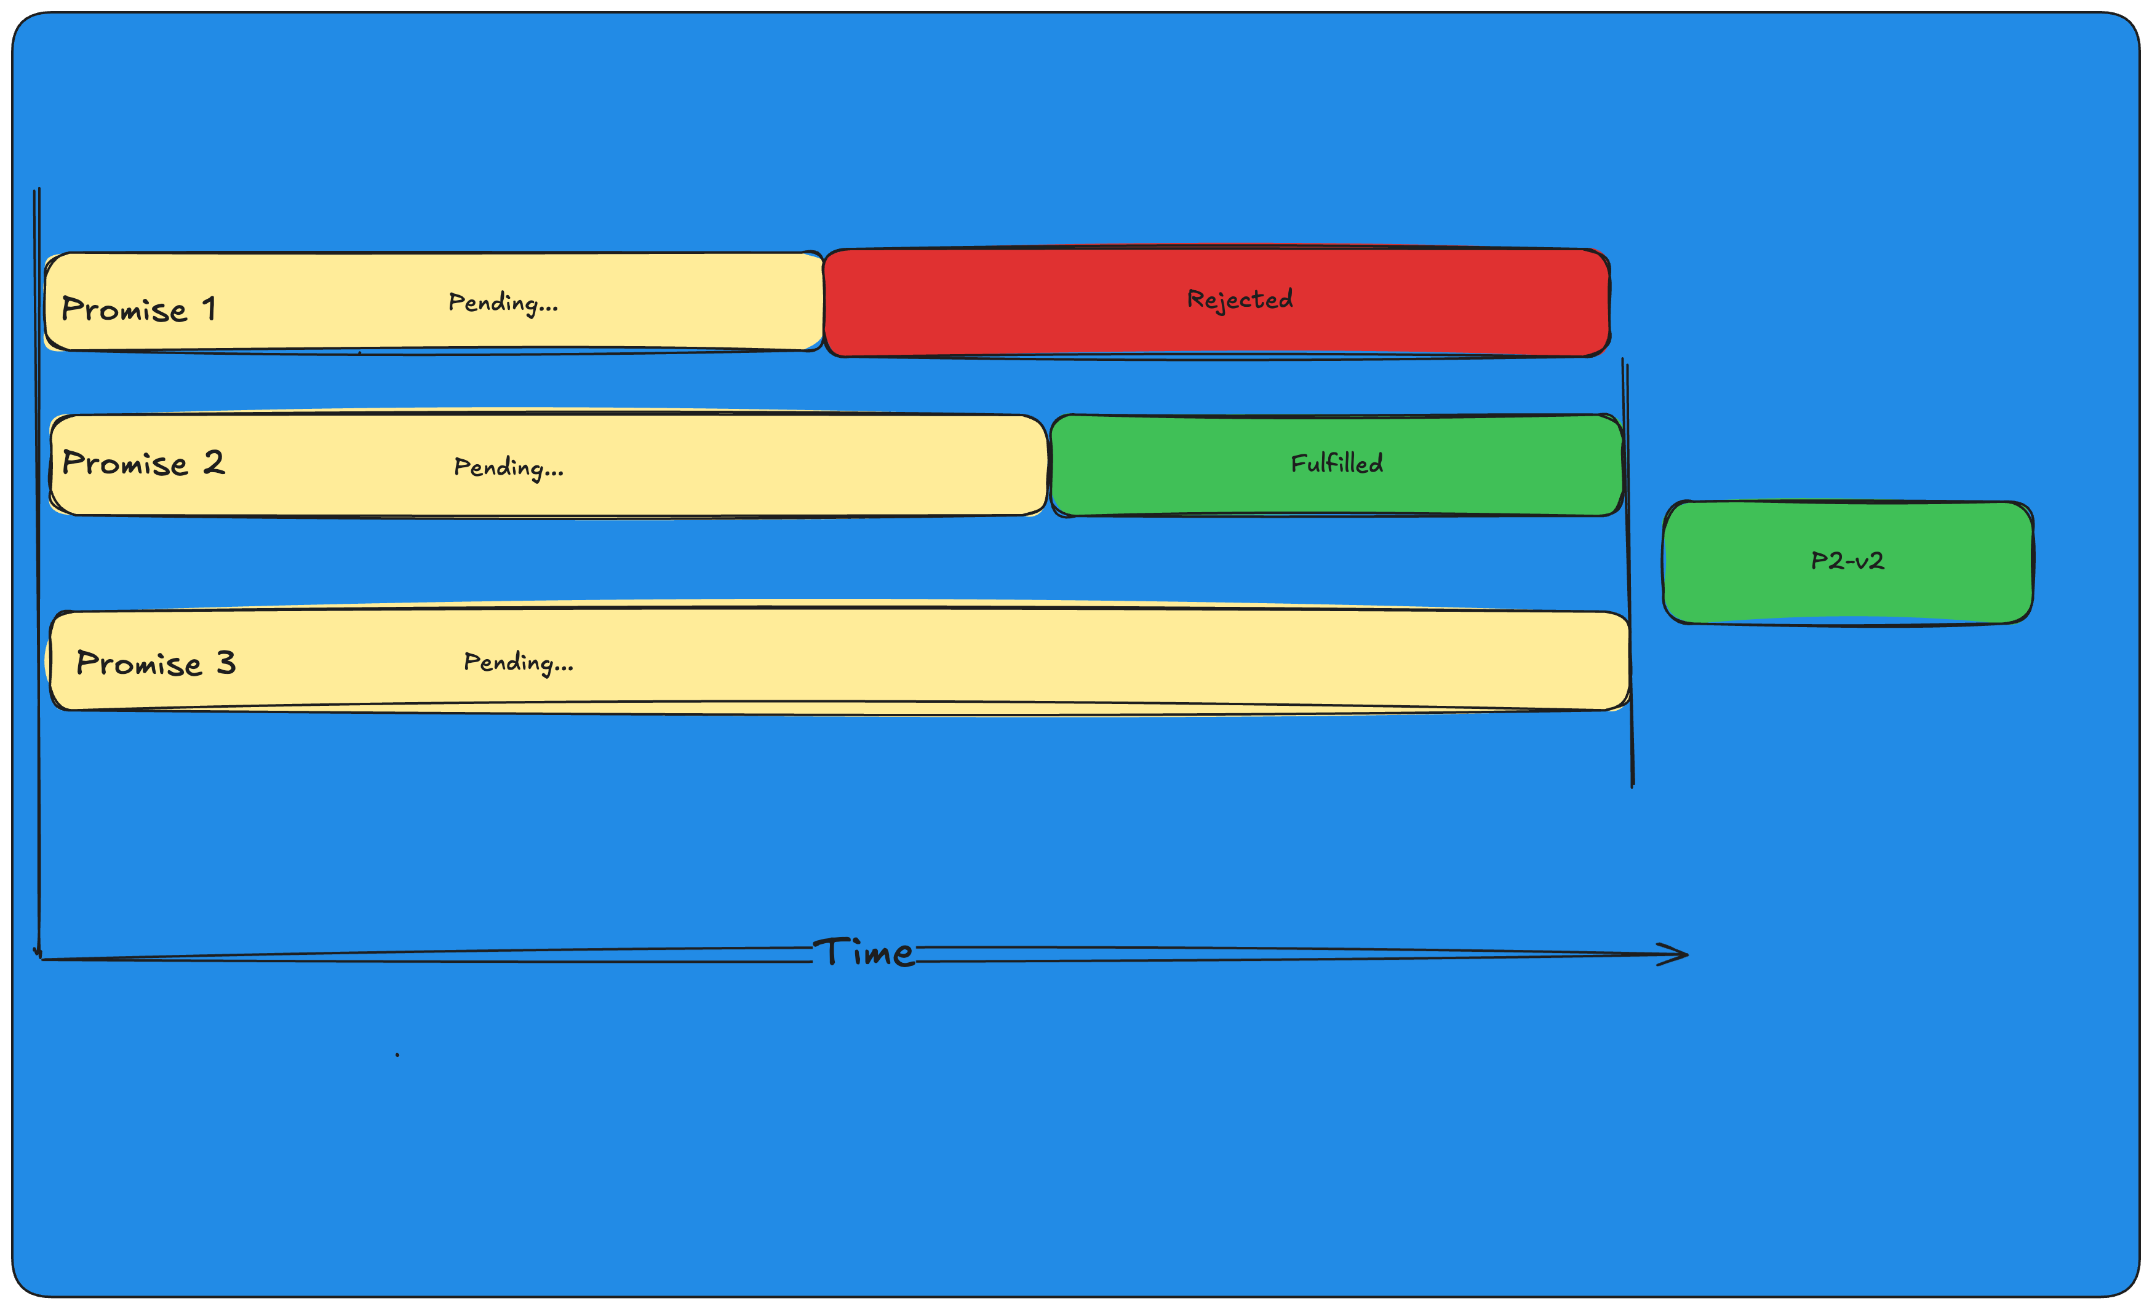
Promise.any()

Slide 30
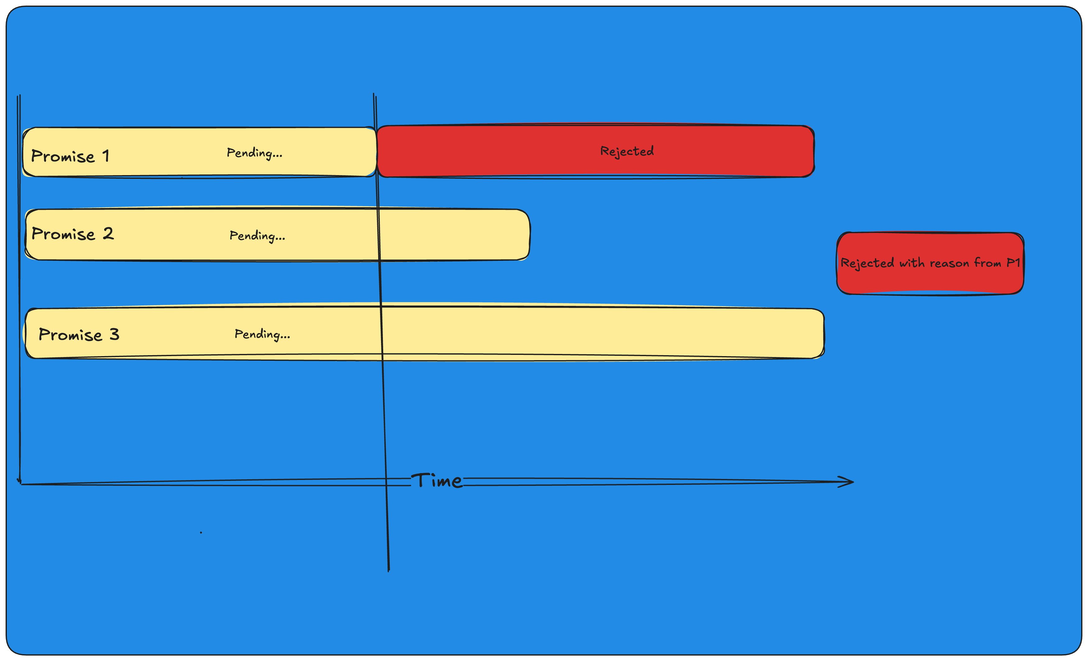
Promise.race()

Slide 31
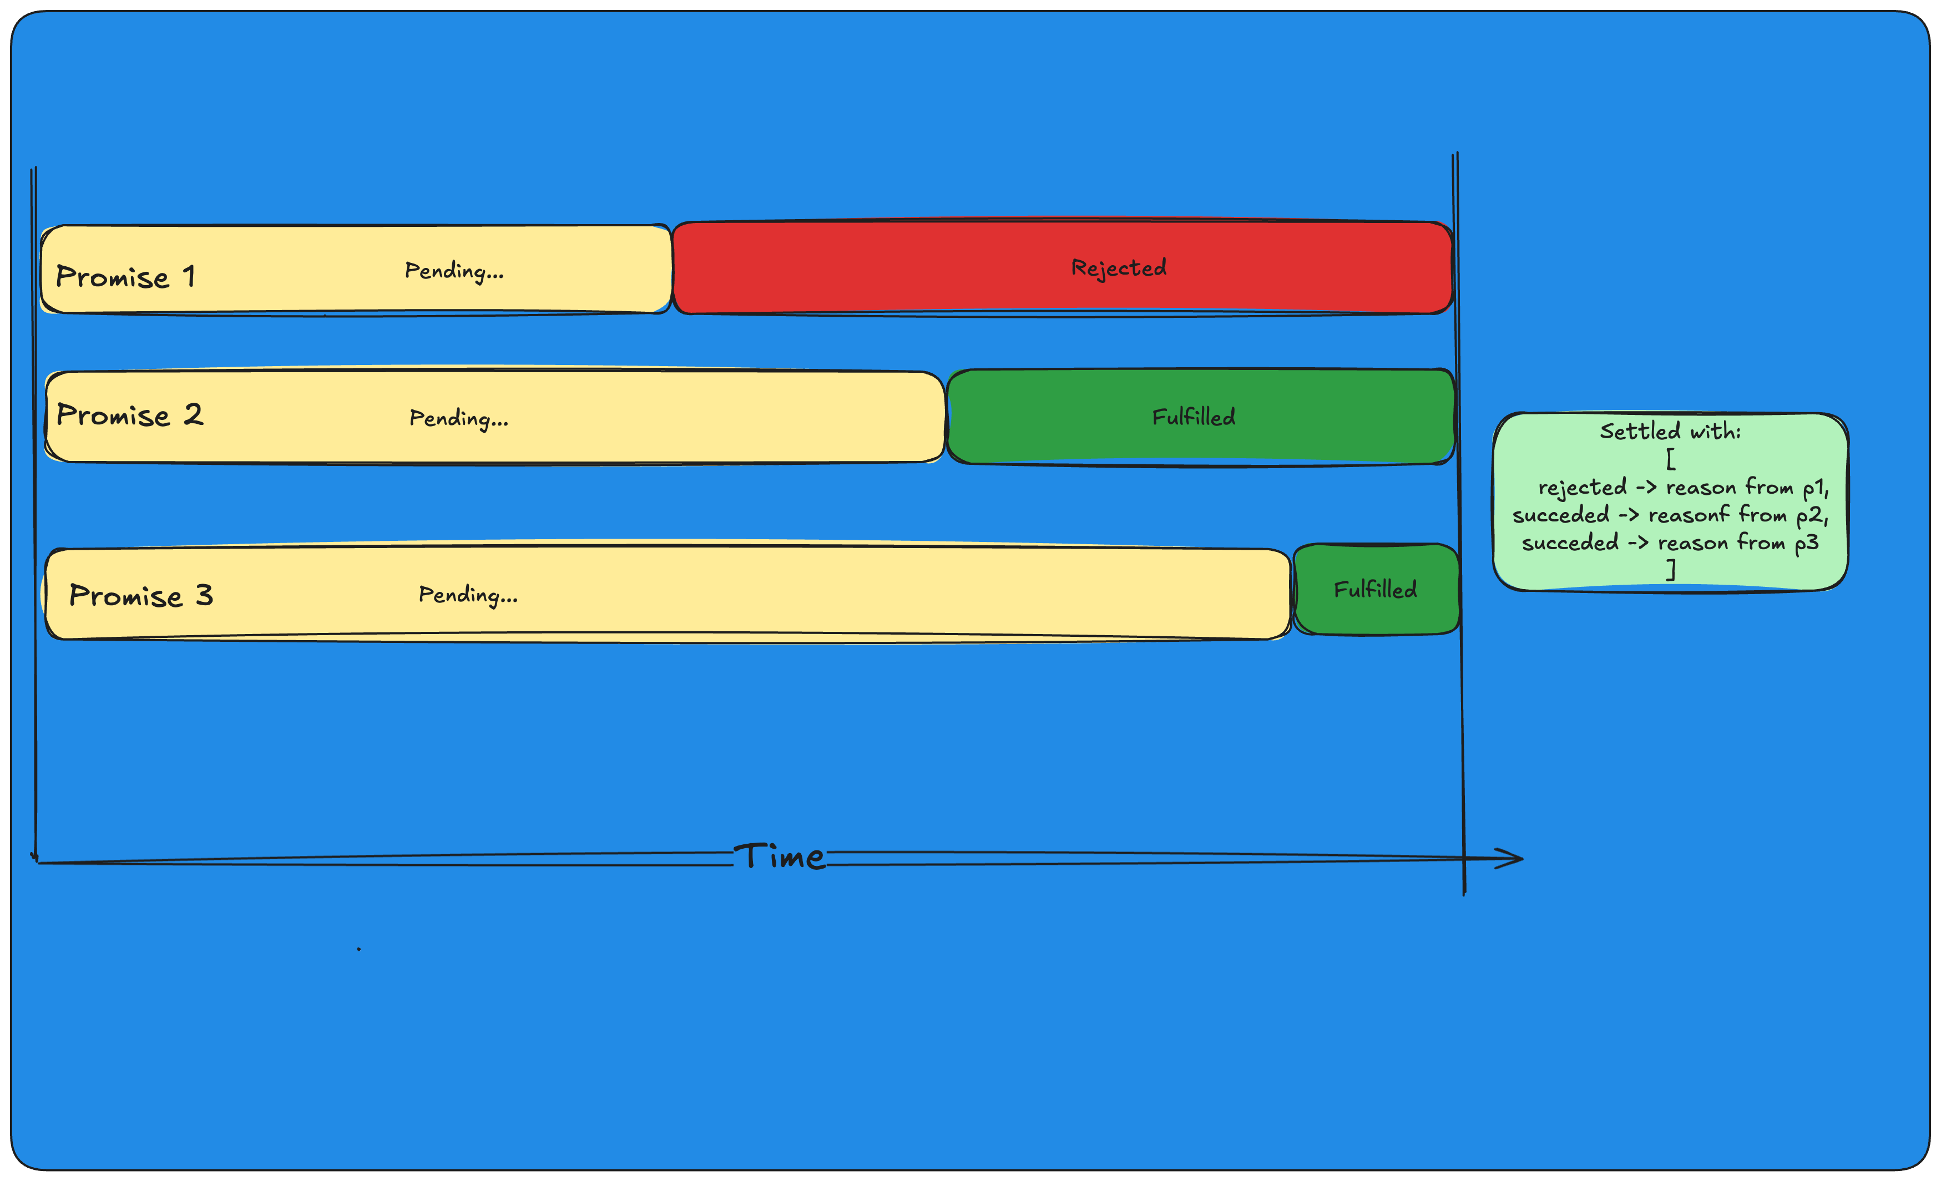
Promise.allSettled()

Slide 32
2.5
Fetch api

Slide 33
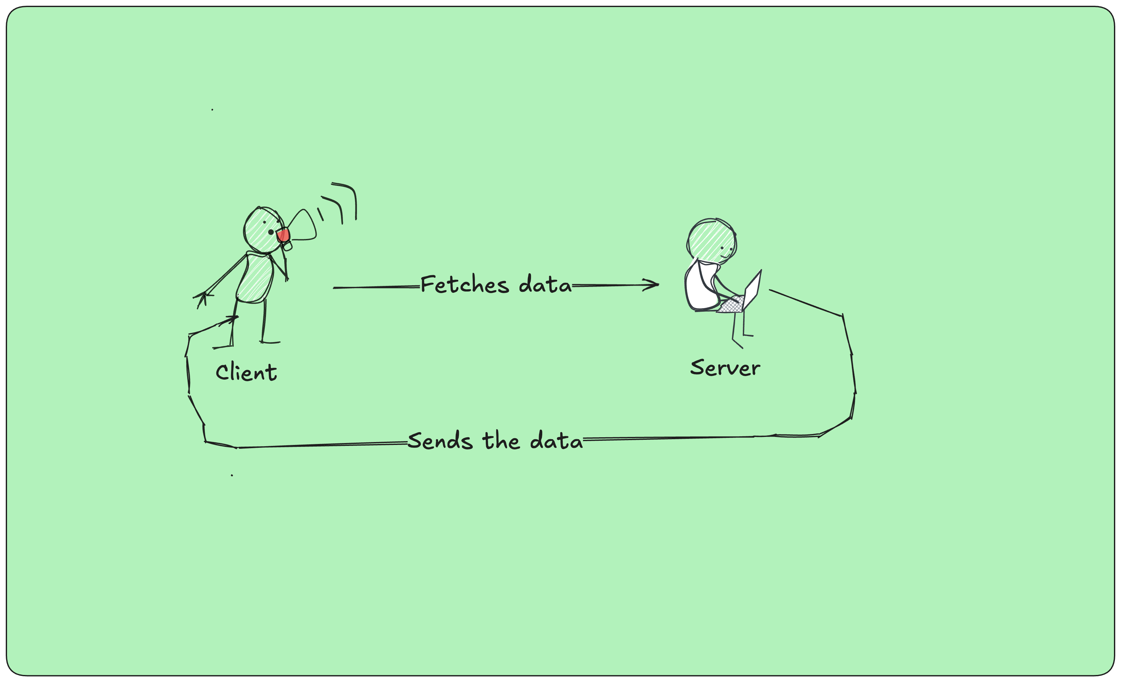
Promise.allSettled()

Slide 34

Day 3
Async programming recap
Introduction to npm
Node.js event loop
Exercises
Free practice

Slide 35
Day 4
Typescript
Exercises
Wrapping up
Resources and next steps

